Slide 1
Wakefields and Impedance
Eric Prebys, FNAL

Slide 2
In our last lecture, we characterized the effects of a beam on its environment as an impedance. We will now generalize this approach.
Consider the effect that one particle can have on subsequent particles through the interaction with the environment (beam pipe, RF cavities, etc)
The fields of a single particle moving relativistically are
If the particle is propagating through a beam pipe, we can express the charge and current densities as (homework)

Slide 3
By symmetry, we expect only
components. We also expect the solution to propagate along the beam pipe with the particle, so we transform to
Recalling the appropriate Maxwell’s equations, we have

Slide 4
For any component of the field f, our transformation imply
Move the integral completely outside, and this becomes

Slide 5
Combining the second and the third gives
Plug this into the first equation, we have
Multiply through by r and integrate

Slide 6
To solve for A, we look at the wall boundary, where
Now our equations become

Slide 7
Plug this back into the first equation
Evaluate at the wall of the beam pipe of radius b
assume
Assume im{λ}>>1/r, so
For r>b
To keep solution finite,
try
Skin depth

Slide 8
To find B_{θ}, use
Integrate and rearrange some terms
Matching the solutions at r=b, we get

Slide 9
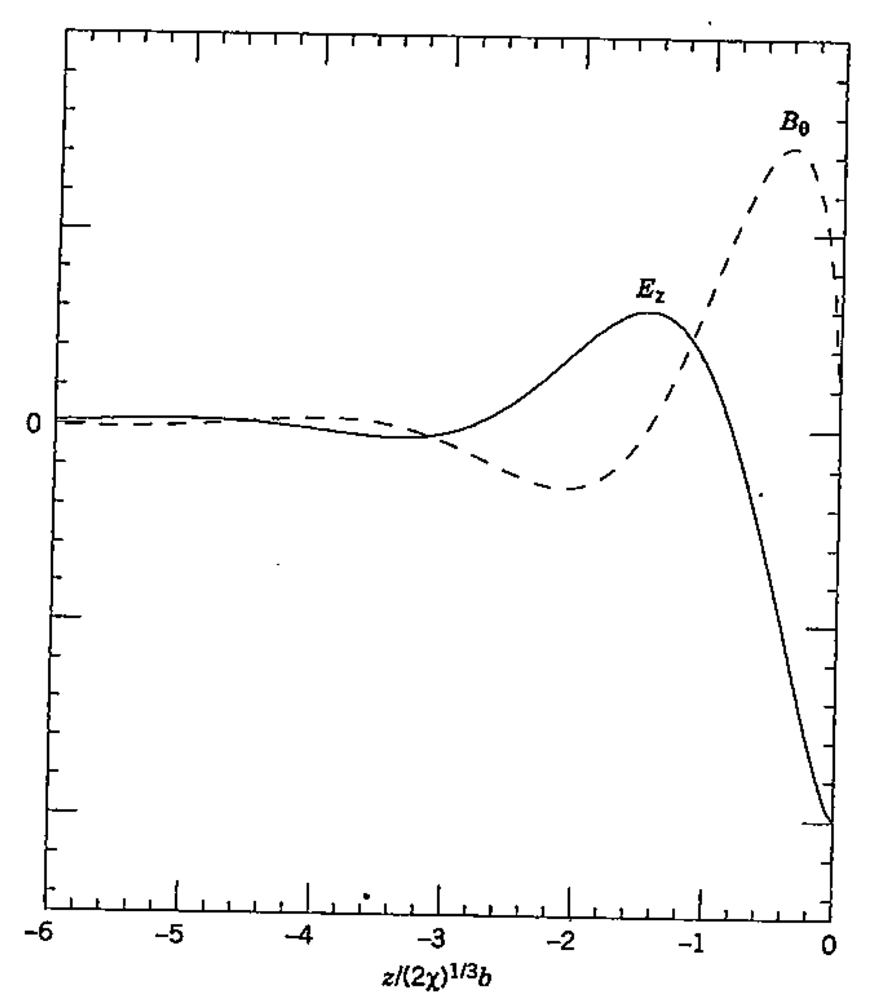
Solve for A, and after a bit of algebra, we get
We now Fourier transform back into the lab frame to get
=0 ahead of particle

Slide 10
Wake Functions
We are looking for a function which describes the effect that particles have on the subsequent particles. We will look for the average fields created by particles in their wake.
Trailing distance
This will represent the average forces that a particle trailing the lead particle will experience a distance s behind the lead particle, due the wakefields it creates. The total time derivative is thus zero

Slide 11
So, for example, the r component of is
convert to z derivative
In terms of forces
We can likewise show (homework) that

Slide 12
We can write a general solution as
Verify for the r direction. We want
Check
✔

Slide 13
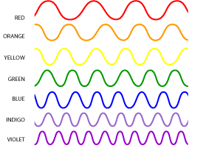
W(s) and W’(s) are called the wake functions. Often, W(s) is referred to as the “transverse wake function” and W’(s) as the “longitudinal wake function”.
Assume a harmonic component of the beam structure
Propagating form
Consider the 0 mode in the longitudinal direction

Slide 14
So we can write the field induced by the charges in front of it as
test point
appears to be a Fourier Transform

Slide 15
Recalling our discussion of the negative mass instability, we define an impedance
We can identify
Generalize
convention, because transverse fields tend to be out of phase

Slide 16
Calculating wakefields and impedances can be very difficult, even in simple geometries; however, we’ll see that if we know they exist, we can say something about their effects, and also about how to measure them.

